Slide 1
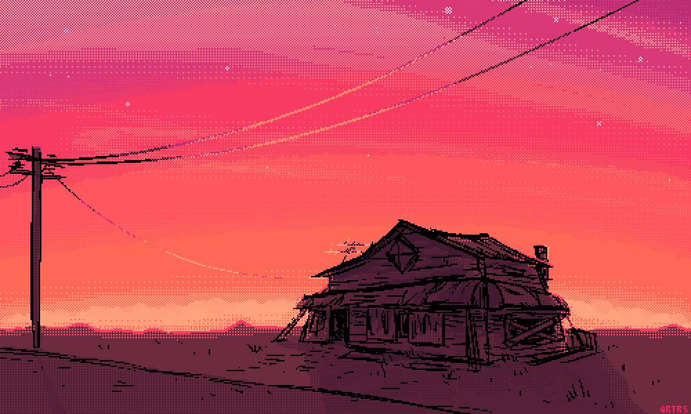
ESCAPE
Created by: Ruby and Kaitlyn
use the arrow keys to control the character & escape the monster.
Remember to collect keys to go to new rooms.
Press space to continue...

Slide 2
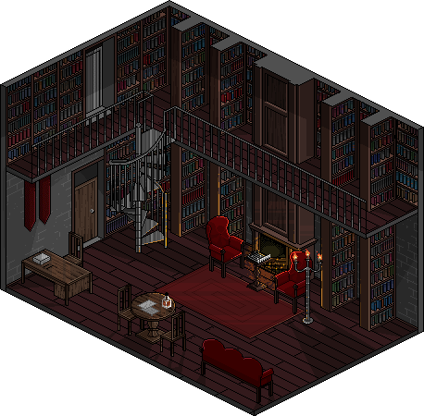

Slide 3
1 OUT OF 3 KEYS FOUND!!!

Slide 6
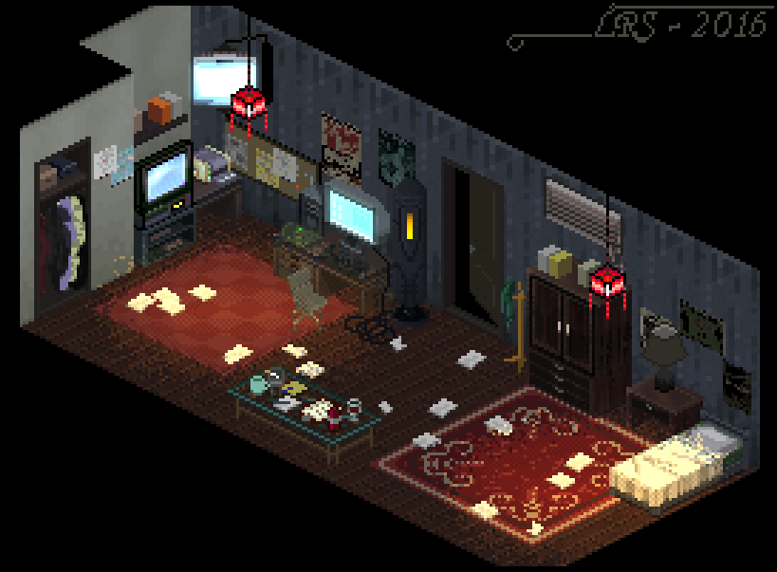

Slide 9

Press Escape to exit

